Slide 1
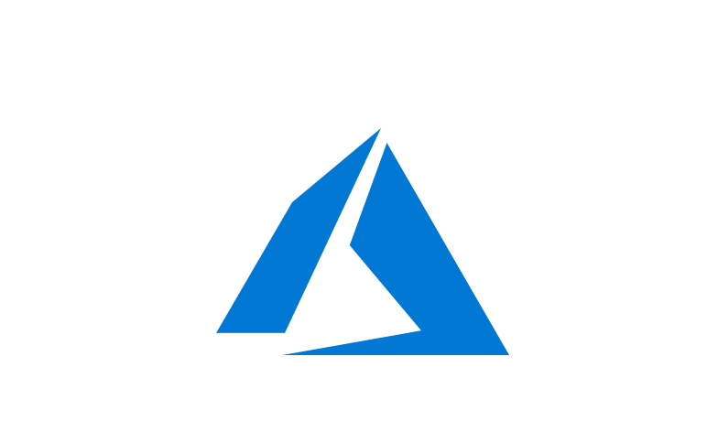
Course Outline
Module 1: Design a Compute Solution
Module 2: Design a Network Solution
Module 3: Design for Migration
Module 4: Design Authentication and Authorization
Module 5: Design Governance
Module 6: Design a Solution for Databases
Module 7: Select an Appropriate Storage Account
Module 8: Design Data Integration
Module 9: Design a Solution for Logging and Monitoring
Module 10: Design a Solution for Backup and Recovery
Module 11: Design for High Availability
Module 12: Design for Cost Optimization
Module 13: Design an Application Architecture
Module 14: Design Security for Applications
NOTE: The module order listed above aligns with the learning objectives described on the AZ-304: Microsoft Azure Architect Design certification page.

Slide 2
AZ-304: Microsoft Azure Architect Design

Slide 3
Module 8: Design Data Integration
Solutions using Azure Data Platform, Data Integration, and Data Warehousing

Slide 4
Learning Objectives
Azure Data Platform End-to-End
Recommend a Solution for Data Integration
Recommend a Solution for Data Warehousing and Big Data Analytics Integration
Migrate On-Premises Data to Cloud Storage with AzCopy
Module Review Questions

Slide 5
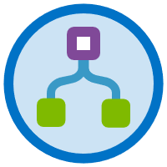
Azure Data Platform End-to-End

Slide 6

Azure Data Platform End-To-End
This solution architecture demonstrates how a single, unified data platform can be used to meet the most common requirements for:
Traditional relational data pipelines
Big data transformations
Unstructured data ingestion and enrichment with AI-based functions
Stream ingestion and processing following the Lambda architecture
Serving insights for data-driven applications and rich data visualization
Topics covered in this lesson include the following:
Use Cases
Architecture
Architecture Components

Slide 7
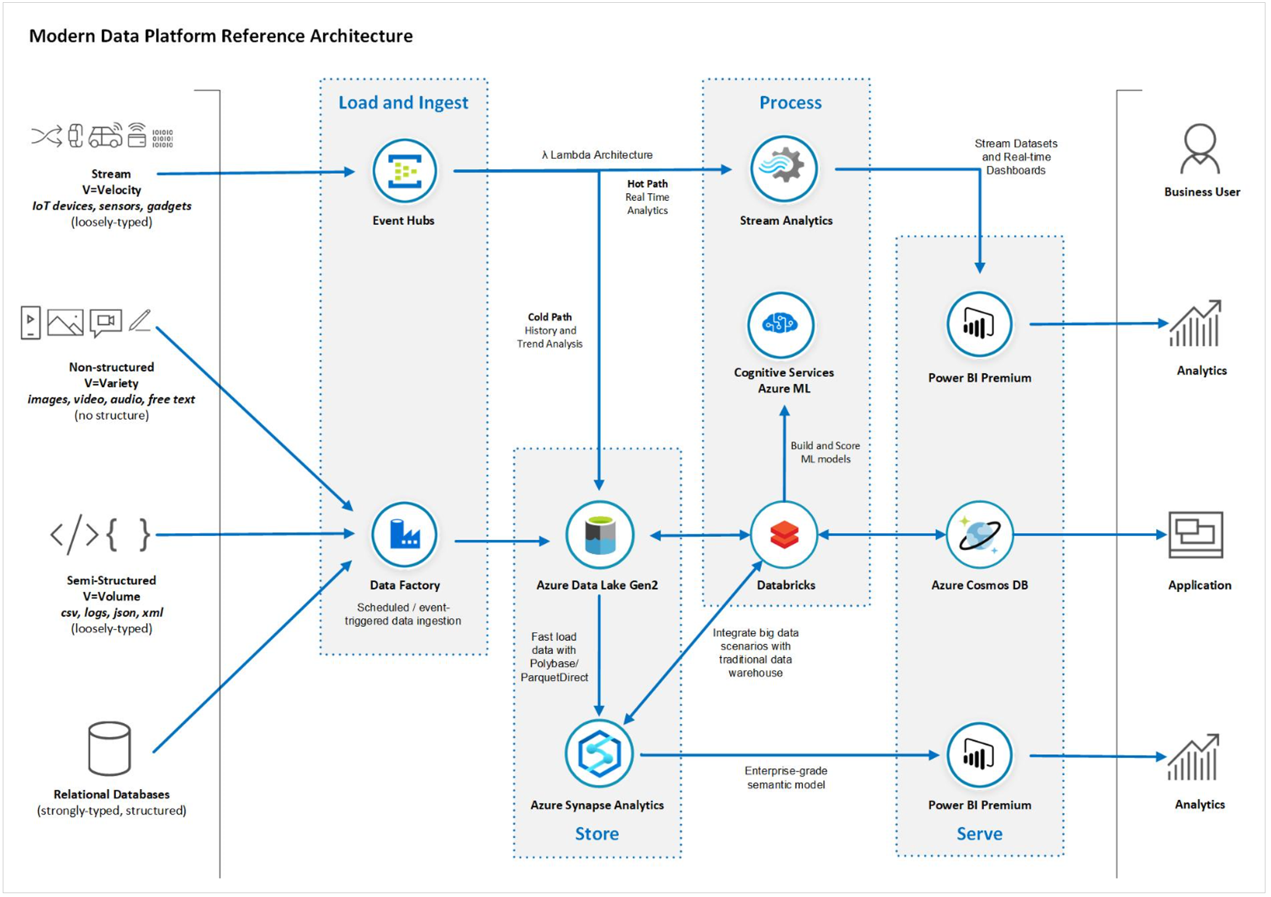
Architecture
Relational databases
Semi-structured data sources
Non-structured data sources
Streaming

Slide 8
Architecture Components
The following Azure services are used in the architecture:
Azure Service | Microsoft Learn | Technical Documentation
Azure Data Factory | Data ingestion with Azure Data Factory | Azure Data Factory Technical Documentation
Azure Synapse Analytics | Implement a Data Warehouse with Azure Synapse Analytics | Azure Synapse Analytics Technical Documentation
Azure Data Lake Storage Gen2 | Large Scale Data Processing with Azure Data Lake Storage Gen2 | Azure Data Lake Storage Gen2 Technical Documentation
Azure Cognitive Services | Cognitive Services Learning Paths and Modules | Azure Cognitive Services Technical Documentation
Azure Cosmos DB | Work with NoSQL data in Azure Cosmos DB | Azure Cosmos DB Technical Documentation
Azure Databricks | Perform data engineering with Azure Databricks | Azure Databricks Technical Documentation
Azure Event Hubs | Enable reliable messaging for Big Data applications using Azure Event Hubs | Azure Event Hubs Technical Documentation
Azure Stream Analytics | Implement a Data Streaming Solution with Azure Streaming Analytics | Azure Stream Analytics Technical Documentation
Power BI | Create and use analytics reports with Power BI | Power BI Technical Documentation

Slide 9
Recommend a Solution for Data Integration

Slide 10
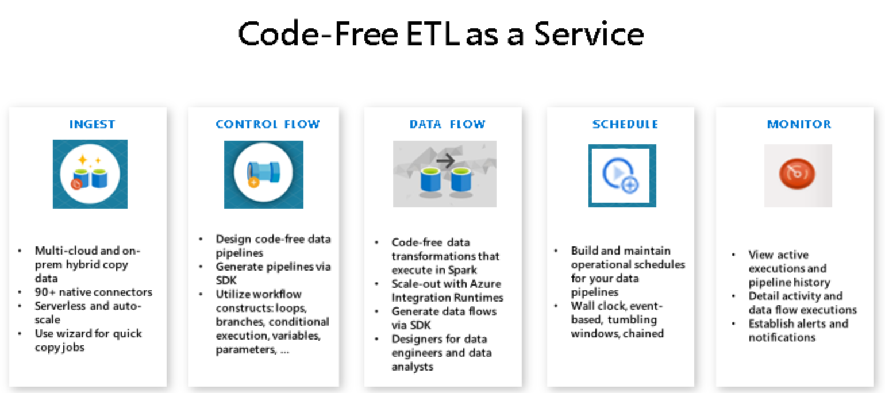
Data Flows using Azure Data Factory
Azure Data Factory is a cloud-based ETL and data integration service
Create and schedule data-driven workflows (pipelines)
Build complex ETL processes
Integrates with other compute services
See: What is Azure Data Factory?
Notes:
Azure Data Factory is a cloud-based ETL and data integration service that allows creation of data-driven workflows for orchestrating data movement and transforming data at scale.
Create and schedule data-driven workflows (called pipelines) that can ingest data from disparate data stores
Build complex ETL processes that transform data visually with data flows
Use compute services such as Azure HDInsight Hadoop, Azure Databricks, and Azure SQL Database

Slide 11
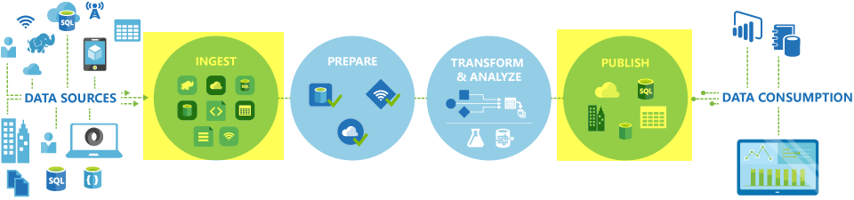
How Data Factory Works
Connect and collect – Copy Activity
Transform and enrich – Execute on Spark
CI/CD and publish – Azure DevOps and GitHub
Monitor - Azure Monitor, API, PowerShell
Notes:
Data Factory contains a series of interconnected systems for data engineers:
Connect and collect: Data Factory uses the Copy Activity in a data pipeline to move data from on-premises and cloud source data stores to a centralization data store in the cloud for analysis.
Transform and enrich: Data flows enable data engineers to build data transformation graphs that execute on Spark… without understanding Spark clusters or programming.
CI/CD and publish: Full support for CI/CD of data pipelines using Azure DevOps and GitHub allows incremental development and delivery of ETL processes before publishing.
Monitor: Built-in support for pipeline monitoring using Azure Monitor, API, PowerShell, Azure Monitor logs, and health panels on the Azure portal.

Slide 12
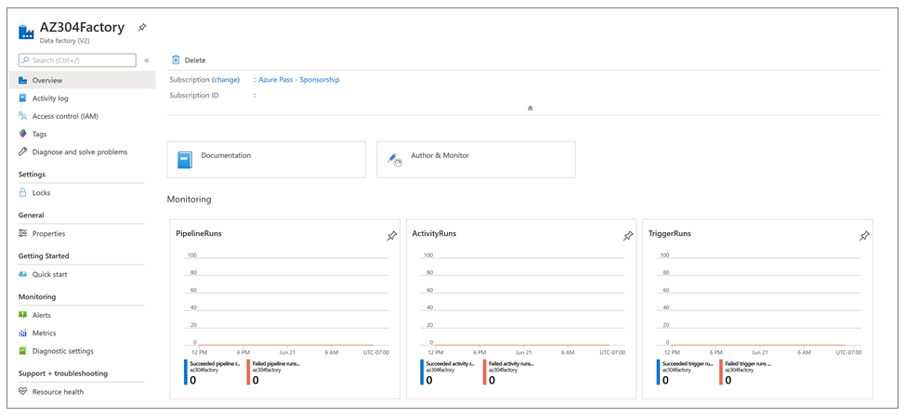
Data Factory Key Concepts
Pipeline
Mapping data flows
Activity
Datasets
Linked services
Triggers
Pipeline runs
Parameters
Control flow
Notes:
Azure Data Factory components work together to provide the platform on which you can compose data-driven workflows with steps to move and transform data. Below are key components within Data Factory:

Slide 13
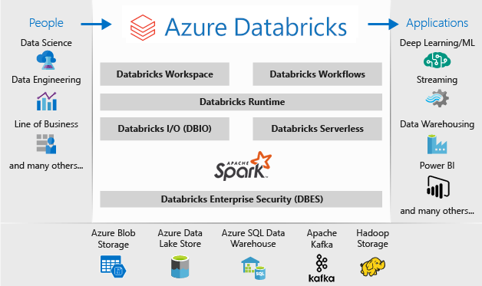
Integrate Data Factory and Databricks
Create an Azure storage account
Create a Data Factory instance - Portal
Create a data workflow pipeline – Copy activity
Add a Databricks notebook to the pipeline
Analyze the data – train data
Notes:
Data ingestion and transformation using Data Factory and Databricks by doing the following:
Create an Azure storage account. You'll use this storage account to store your ingested and transformed data.
Create a Data Factory instance. After you set up your storage account, create your Data Factory instance by using the Azure portal.
Create a data workflow pipeline. To create the pipeline, copy data from your source by using a copy activity in Data Factory. A copy activity allows you to copy data from different on-premises and cloud sources.
Add a Databricks notebook to the pipeline. This notebook contains the code to transform and clean the raw data as required.
Analyze the data. Now that your data is cleaned up, use Databricks notebooks to further train the data or analyze it to output the required results.

Slide 14
Recommend a Solution for Data Warehousing and Big Data Analytics Integration

Slide 15
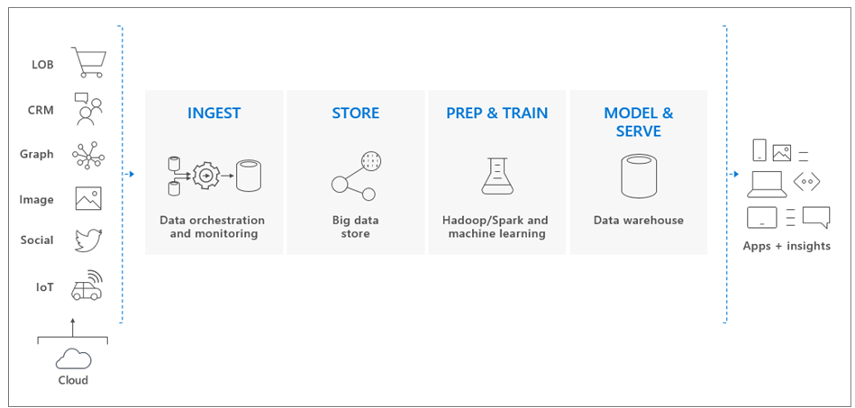
Azure Synapse Analytics
Synapse SQL
Spark
Synapse Pipelines
Studio (preview)
Data Flow:
Ingest Data
Prepare Data (Hadoop, Spark, and machine learning)
PolyBase to query big data stores
T-SQL queries to populate pool tables
Stores data in relational tables with columnar storage
Notes:
Data Flow:
Data is ingested into big data stores from multiple sources.
Hadoop, Spark, and machine learning algorithms prepare and train the data
Synapse SQL pool uses PolyBase to query the big data stores
PolyBase uses standard T-SQL queries to bring the data into Synapse SQL pool tables.
Synapse SQL pool stores data in relational tables with columnar storage.

Slide 16
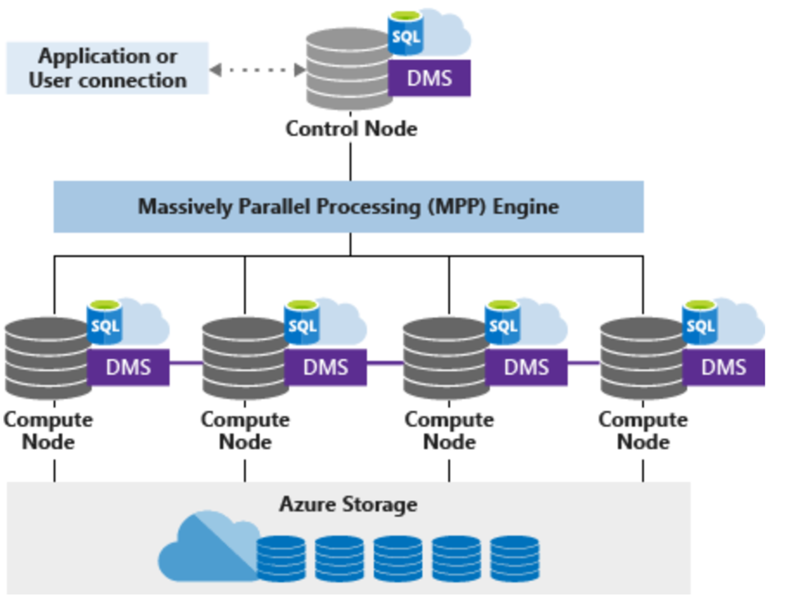
Azure Synapse Analytics Architecture
Azure Storage
Hash
Round Robin
Replicate
Control node
The MPP engine
T-SQL query
Compute nodes
Distributed processing
Data Movement Service
Transport between notes
Notes:
Azure Storage: Synapse SQL uses Azure Storage where data is sharded into distributions to optimize the performance. The following sharding patterns are available:
Hash
Round Robin
Replicate
Control node is the front end that interacts with all applications and connections.
The MPP engine runs on the Control node to optimize and coordinate parallel queries.
When a T-SQL query is submitted, the Control node transforms it into queries that run against each distribution in parallel.
Compute nodes provide the computational power.
Distributions map to Compute nodes for processing.
As you pay for more compute resources, distributions are remapped to available Compute nodes.
Data Movement Service is the data transport technology that coordinates data movement between the Compute nodes.

Slide 17
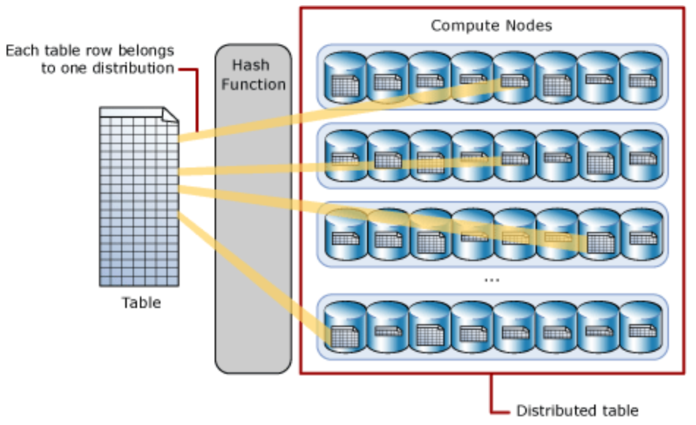
Distributions
Hash-Distributed Tables
Each row belongs to one distribution
A deterministic hash algorithm assigns each row to one distribution
The number of table rows per distribution varies
Round-Robin Distributed Tables
A round-robin distributed table distributes data evenly across the table
A distribution is first chosen at random
Notes:
Hash-Distributed Tables
In the table definition, one of the columns is designated as the distribution column. The hash function uses the values in the distribution column to assign each row to a distribution.
Each row belongs to one distribution
A deterministic hash algorithm assigns each row to one distribution
The number of table rows per distribution varies as shown by the different sizes of tables
Round-Robin Distributed Tables
A round-robin distributed table distributes data evenly across the table but without any further optimization.
A distribution is first chosen at random and then buffers of rows are assigned to distributions sequentially

Slide 18
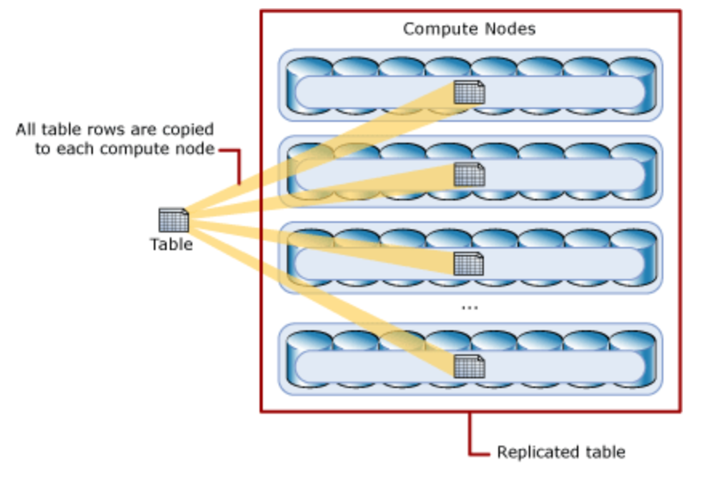
Replicated Tables
A replicated table caches a full copy of the table on each compute node
Removes the need to transfer data among compute nodes
Best with small tables
Notes:
A replicated table caches a full copy of the table on each compute node
Consequently, replicating a table removes the need to transfer data among compute nodes before a join or aggregation
Replicated tables are best utilized with small tables
Extra storage is required and there is additional overhead that is incurred when writing data... making large tables impractical

